Slide 1
Redefining Leadership
Part 2
Ryan Knudson- Legacy1864

Slide 2
Paradigm Shift for Leaders

Slide 3
Visionary Leaders
Bold
Decisive
Keeps the vision alive
Excited
Stakeholder buy-in
Simplifies complex ideas
Trailblazer
Energetic
Strong Communication
Vision Caster
Dot Connector
Disruptive
Constantly reinventing oneself

Slide 4
Relational Leaders
Communication
Directs
Vulnerable
Trustworthy
Inspirational
Growing Leaders
Healthy Conflict
Identifies Talent
Self-aware
Driven
Asks for help
Serves
Coachable

Slide 5
Result-Oriented Leaders
Fearless Decision maker
Credit where credit is due
Driving Profit
World-class driven
Disruption Mindset
Delegation
Business Acumen
Healthy Accountability
Challenge things
Out-of-the-box thinker
Cares deeply about outcomes
Uses data to make decisions
Operational Excellence
Challenge each other

Slide 6
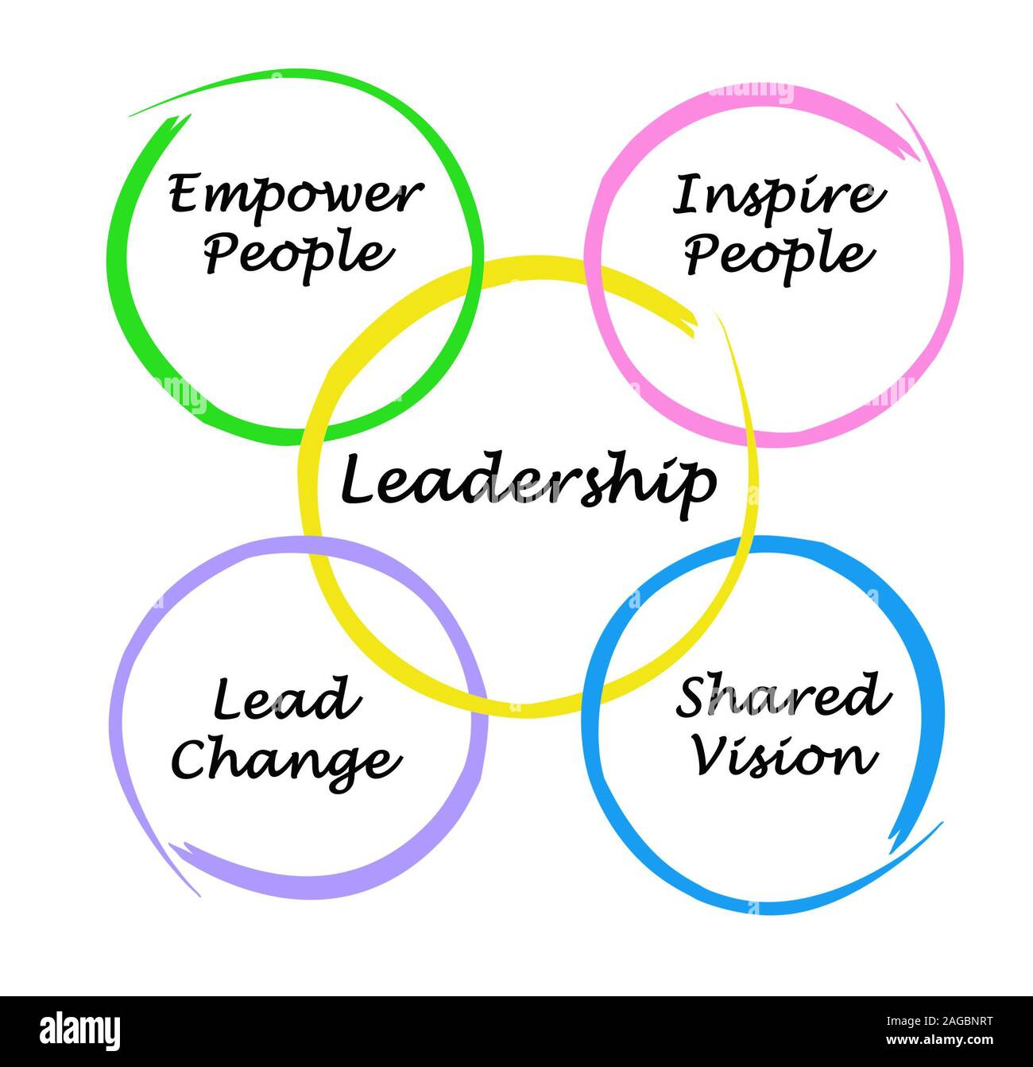
Paradigm Shift for Leaders
Leaders must take the first step, especially when involving risk
Relationships are key in leadership
Importance of adapting methods while staying true to principles
Benefits of a shared sense of urgency, where everyone leads

Slide 7
Relational Leadership
Build strong relationships based on care and approachability
Foster a sense of community and support
Encourage vulnerability and open communication

Slide 8
Why Relational Leadership is key
Importance of building strong relationships, transparency, and vulnerability
Need to create a sense of community and support
Value of making team members feel heard and valued

Slide 9
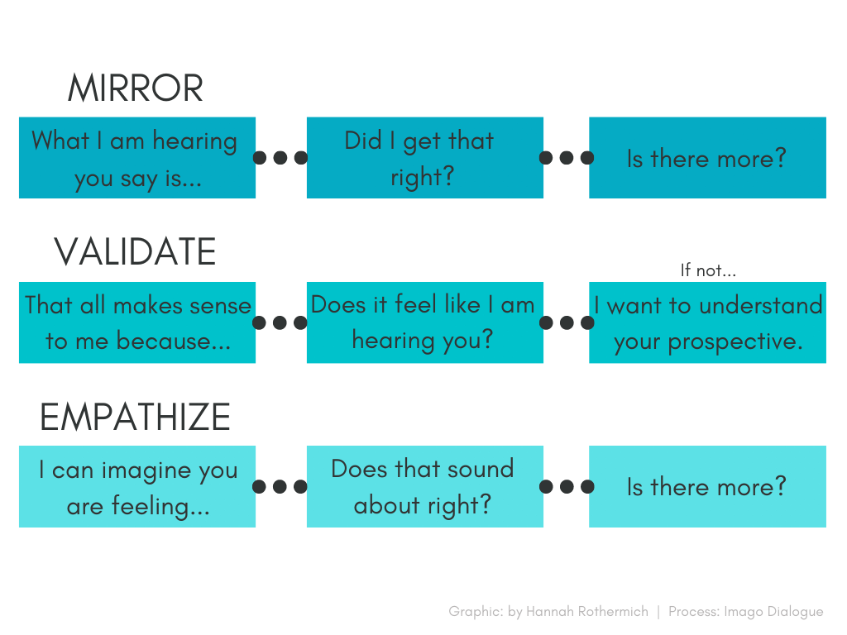
Imago Dialogue Workshop

Slide 10
Developing Leaders
Importance of a clear path for growth and development
Value of responsible delegation and feedback systems
Need for training focused on improvement with clear expectations
Benefits of collaboration, acknowledgment, and recognition

Slide 11
Practical Workshop

Slide 12
After Action Review
After Action Review Worksheet
What is Working? Double Down | What is Broken? Fix It
What is Confused? Clarify | What is Missing? Add

Slide 13
Key Takeaways
Leadership is about Connection: Leaders must build strong relationships, be transparent and vulnerable, and empower their team to share in leadership. Principles are constant, but methods must adapt.
Relational Leadership Matters: Fostering empathy, safety, and open communication helps teams thrive. Tools like the Imago Dialogue can model effective relational leadership.
Clear Paths and Feedback Drive Growth: Clearly communicate development opportunities, value team input, and set measurable expectations. Alignment with personal goals and meaningful acknowledgment are key.

Slide 14
Legacy1864
Consulting

